Slide 1
A Daily
Routine.
МБОУ СОШ № 28 п. Тамань
Учитель Сикалова Галина Николаевна

Slide 2
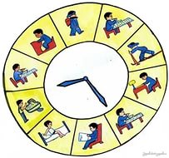
Leave
Snack
Get home-
Come back
Wakeup
Have dinner
Do homework
Have breakfast

Slide 3
Choose the right preposition. (p.45)
Sunday
the morning
5 o’clock
midnight
one o’clock … the evening
midday
winter
ten minutes to seven
the 1st of November
summer
Wednesday
in
on
at

Slide 4

PP
Вспомните, какие окончания вы написали в глаголах (verbs) во времени Present Simple. Заполните схему:
PRESENT SIMPLE

Slide 5
PP
Проверьте, правильно ли вы заполнили схему:
PRESENT SIMPLE
V
Vs (es)
I
you
we
they
he
she
it
Score:
__ / 1 point

Slide 6
Work in the groups
Find mistakes
1
She get up at 6 o’clock.
Then she washes his face and clean your tooth.
He has her breakfast and go to school on bus.
She don’t like his journey.
2
We gets up at 7 o’clock.
Then we washes my face and clean your tooth.
We has her breakfast and goes to school on car.
We don’t like their journey.

Slide 7
LET’S CHECK UP
She gets up at 6 o’clock.
Then she washes her face and cleans her teeth.
She has her breakfast and goes to school on bus.
She doesn’t like her journey.
We gets up at 7 o’clock.
Then we washes our face and clean our teeth.
We have our breakfast and goes to school on car.
We don’t like our journey.

Slide 8
Listening
Your task is to listen and watch and translate.

Slide 9
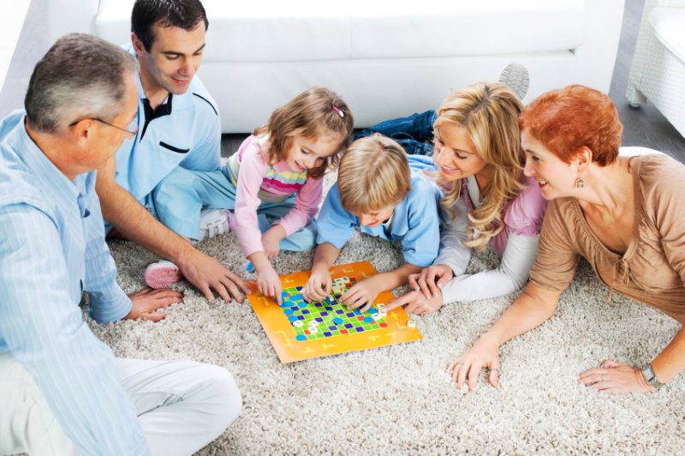
Speaking
In your family what do you do usually in the evening?
Speak about it.
Ex.9 p.35

Slide 10





GOOD JOB!
Choose a smile for your own according to your work at the lesson.
Be objective!
I did all my best! Excellent!
I tried as much as I could. Rather good!
I should learn English better!
Not very well…

